Slide 1

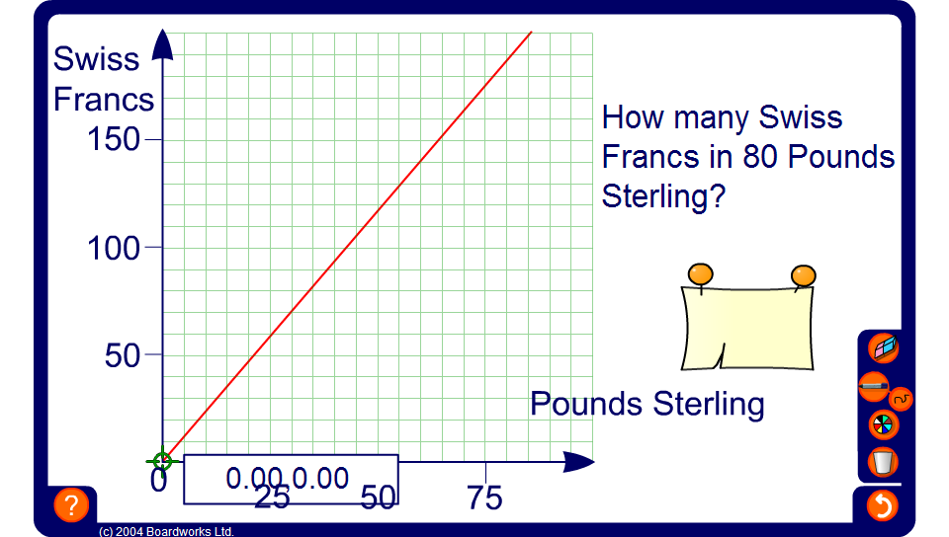


Conversion graphs – money
Notes:
The graph on the board shows a graph for converting Swiss Francs to Pounds Sterling.
Point out that different scales have been used for the horizontal and vertical axes. Ask what one square along the horizontal axis represents and what one square along the vertical axis represents.
Point out, too, that the axes must always be labelled and the graph must always have a suitable title.
Drag the point along the line to demonstrate a variety of Franc to Pound and Pound to Franc conversions.
Ask pupils, Would it make sense to have negative values?

